Slide 1
Session 5
Deployment models(Part 2)

Slide 2
Objectives
Community Cloud
Hybrid Cloud

Slide 3
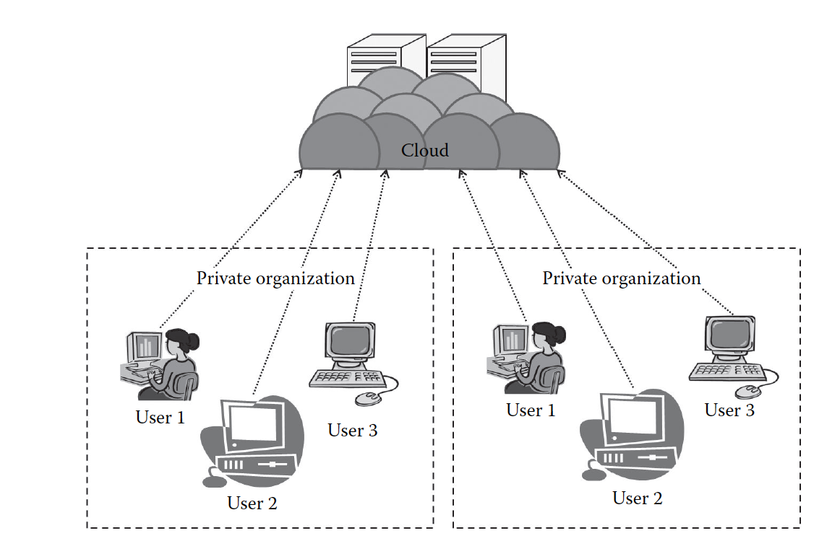
Community Cloud
According to NIST, the community cloud is the cloud infrastructure that is provisioned for exclusive use by a specific community of consumers from organizations that have shared concerns (e.g., mission, security requirements, policy, and compliance considerations).
It is a further extension of the private cloud.
This model is very suitable for organizations that cannot afford a private cloud and cannot rely on the public cloud either.

Slide 4
Community Cloud’s Characteristics
Collaborative and distributive maintenance: The community cloud is wholly collaborative, and usually no single party has full control over the whole cloud
Partially secure: few organizations share the cloud, so there is a possibility that the data can be leaked from one organization to another, though it is safe from the outside world
Cost effective: the whole cloud is being shared by several organizations or a community. Usually, not only cost but every other sharable responsibilities are also shared or divided among the groups

Slide 5
Community cloud’s Suitability
Want to establish a private cloud but have financial constraint
Do not want to complete maintenance responsibility of the cloud
Want to establish the cloud in order to collaborate with other clouds
Want to have a collaborative cloud with more security features than the public cloud

Slide 6
The community cloud is not suitable for the following
Prefer autonomy and control over the cloud
Does not want to collaborate with other organizations

Slide 7
Community cloud classification
There are two types of community cloud deployments:
On-premise community cloud
Outsourced community cloud

Slide 8
On-Premise Community Cloud
On-premise community cloud consists of the cloud deployed within the premises and is maintained by the organizations themselves

Slide 9
On-Premise community Cloud issues
Base on the textbook on page 58 explain some issues of On-Premise community Cloud

Slide 10
Outsourced Community Cloud
In the outsourced community cloud, the cloud is outsourced to a third party. The third party is responsible for maintenance and management of the cloud.

Slide 11
Outsourced Community Cloud issues
Comparing outsources community cloud issues with on premise community cloud issues. In you opinion which one is the most important: SLA, Network, Security and privacy, Laws, Location, Performance, Maintenance?

Slide 12
Community cloud’s advantages
It allows establishing a low-cost private cloud.
It allows collaborative work on the cloud.
It allows sharing of responsibilities among the organization.
It has better security than the public cloud.

Slide 13
Community cloud’s disadvantages
Autonomy of an organization is lost.
Security features are not as good as the private cloud.
It is not suitable if there is no collaboration.

Slide 14
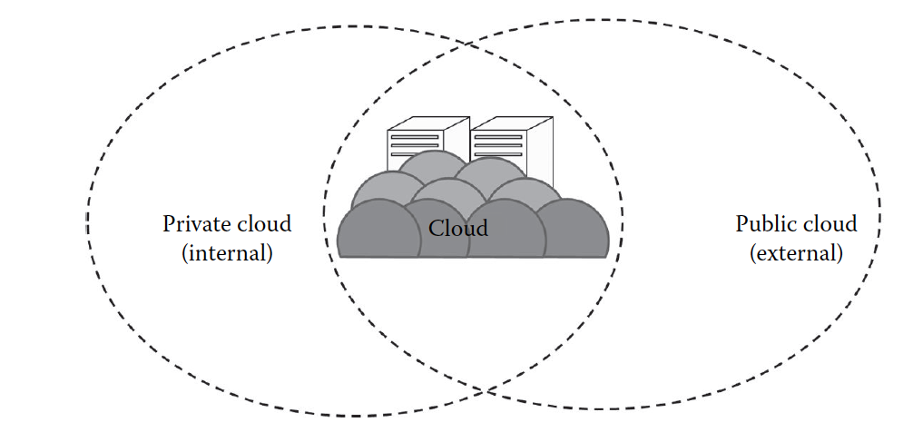
Hybrid Cloud
According to NIST, the hybrid cloud can be defined as the cloud infrastructure that is a composition of two or more distinct cloud infrastructures (private, community, or public) that remain unique entities but are bound together by standardized or proprietary technology that enables data and application portability
The hybrid cloud usually is a combination of both public and private clouds
This is aimed at combining the advantages of private and public clouds

Slide 15
Hybrid Cloud’s Characteristics
Scalable: Usually, the private with public cloud gives hybrid cloud . The public cloud is used whenever needed; hence, as the public cloud is scalable, the hybrid cloud with the help of its public counterpart is also scalable
Partially secure: The private cloud is considered to be secured, but as the hybrid cloud also uses the public cloud, there is high risk of security breach
Stringent SLAs: As the hybrid cloud involved a public cloud intervention, the SLAs are stringent
Complex cloud management: Cloud management is complex and is a difficult task in the hybrid cloud as it involves more than one type of deployment models and also the numbers of users are high

Slide 16
Hybrid Cloud’s Suitability
Organizations that want the private cloud environment with the scalability of the public cloud
Organizations that require more security than the public cloud

Slide 17
The Hybrid cloud is not suitable, where the following applies
Organizations that consider security as a prime objective
Organizations that will not be able to handle hybrid cloud management

Slide 18
Hibrid Cloud’s Issues
Students work in group to discuss those issues, the factors can be found on page 62 of the book

Slide 19
Hybrid Cloud’s advantages
It gives the power of both the private and public clouds.
It is highly scalable.
It provides better security than the public cloud.

Slide 20
Hybrid Cloud’s disadvantages
The security features are not as good as the public cloud.
Managing a hybrid cloud is complex.
It has stringent SLAs.

Slide 21
Summary
The types and characteristics of
Community cloud
On Premise Community cloud
Outsourced Community cloud
Hybrid cloud

Slide 22
References

